Slide 1
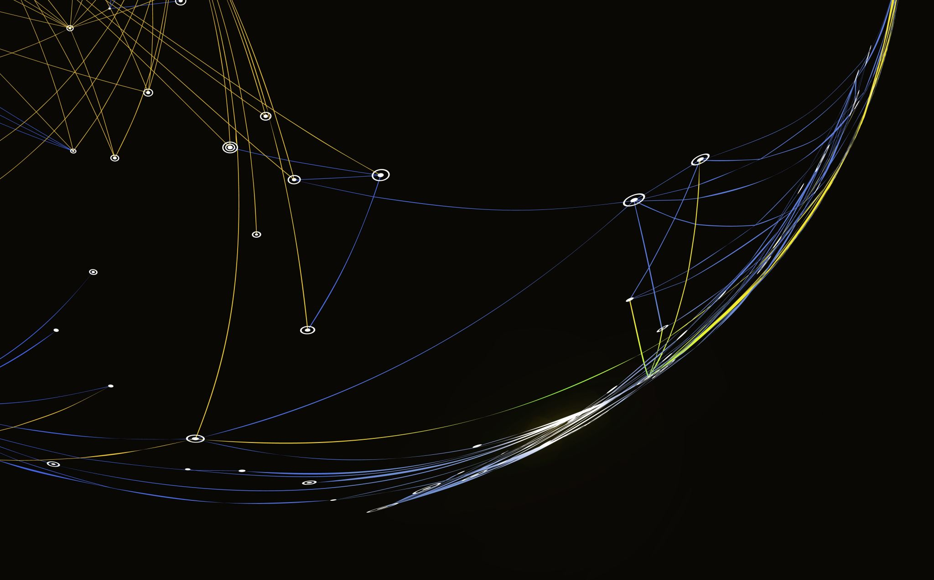

Diagnosis of Autism in Children using Facial Analysis and Deep Learning

Slide 2
motivation
Prevalence: ASD affects a significant number of children, with the CDC reporting 1 in 59 diagnosed in 2018.
Spectrum of presentations: ASD encompasses a wide range of abilities, making diagnosis challenging.
Early diagnosis is key: Early intervention can greatly benefit individuals with ASD

Slide 3

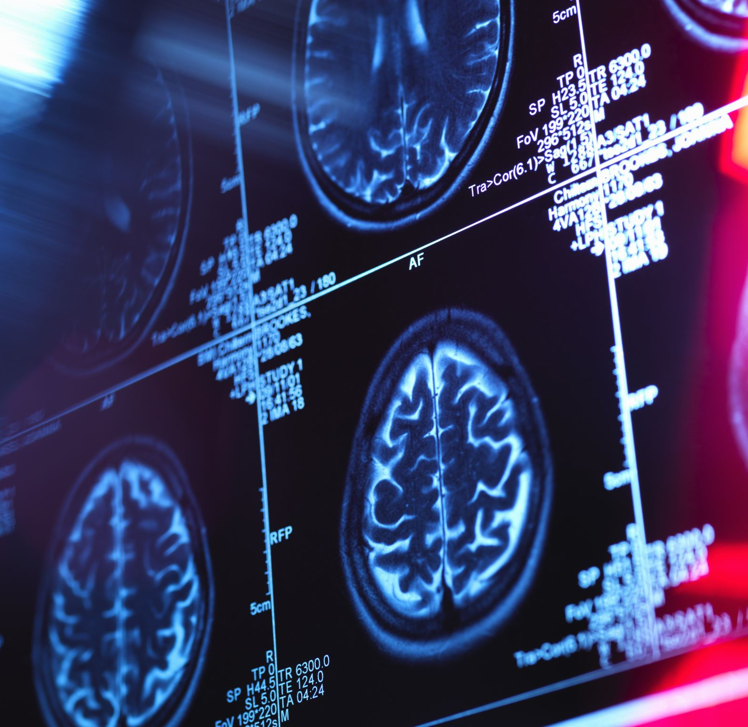
Current Diagnosis:
ASD diagnosis relies on behavioral assessment, despite being believed to have genetic roots.

Slide 4

Proposed Approach
This project investigates the feasibility of using facial recognition technology to diagnose ASD
Scientific basis: A study from the University of Missouri suggests facial feature distinctions in children with ASD.

Slide 5

Data and Methodology:
Dataset: We will utilize a dataset from Kaggle containing over 3,000 images of autistic and non-autistic children.
Data Split:
Training, Testing, and Validation: The dataset comes pre-split, allowing for model evaluation and quality control without relying solely on accuracy.
Balanced Distribution: The training data features an equal number of autistic and non-autistic images (1327 each).
Consolidated Option: For pre-trained models, the consolidated format offers flexibility in training and testing data allocation.

Slide 6

Continued State of the Art

Slide 7

Building upon existing facial analysis techniques
Age and Gender Classification: We leverage research on facial analysis using neural networks, like the work by Wen-Bing Horng et al. who achieved promising results (around 90%) in classifying age groups using geometric and wrinkle features.
Real-Life Image Analysis: Similar to Caifeng Shan et al.'s study (achieving 94.81% accuracy for gender classification), we utilize real-life images in our dataset, acknowledging the limitations of prior studies that relied on controlled environments

Slide 8
Applying Techniques to Autism Classification:
Brain Imaging vs. Facial Recognition: We contrast existing methods, like the study by Auman El-Baz et al. that analyzes brain scans for autism classification, with our proposed approach. While their method achieved success, it required expensive brain scans and is limited to deceased individuals. Our system aims for similar accuracy (around 94.64%) using readily available facial images, offering a non-invasive and potentially more cost-effective alternative

Slide 9
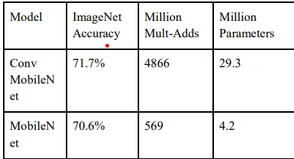
Depthwise Separable vs Full Convolution MobileNet1

Slide 10

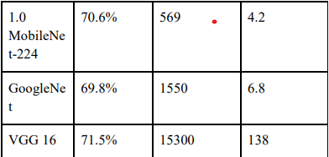
MobileNet Comparison to Popular Models

Slide 11
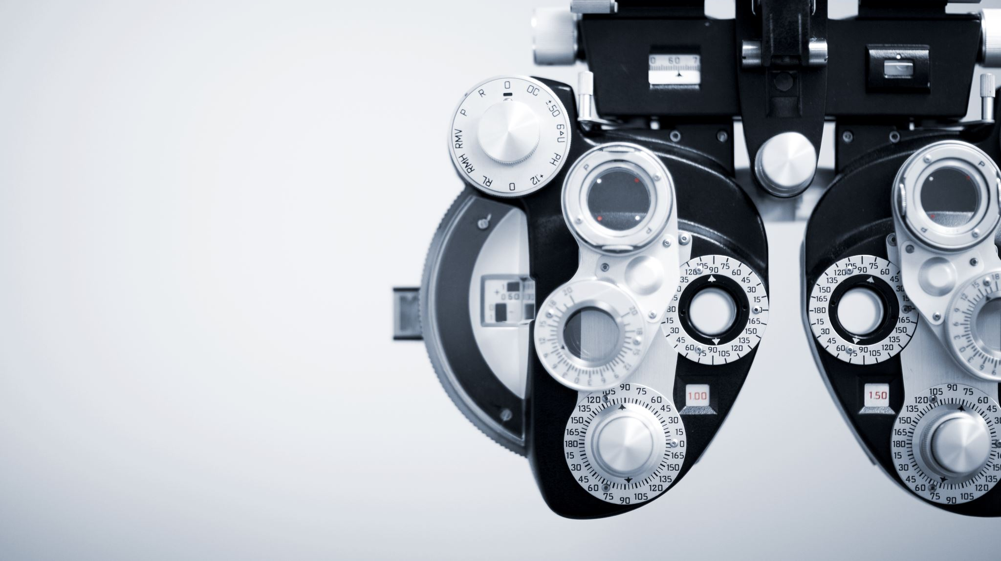
Continued Methods Section

Slide 12
Data Acquisition and Preprocessing:
Source and Labeling: Our dataset of 3,014 children's facial images was obtained from Kaggle. However, it's important to acknowledge the limitations of this approach:
Unverified Labels: The images were labeled as "autistic" or "healthy" based on information from online sources (Facebook groups, Google Image searches) without independent verification. This raises concerns about the accuracy of these labels.
Potential Bias: Sourcing images from online platforms may introduce bias, as such platforms may not represent the full spectrum of the population.
Image Cropping and Splitting: The faces in the images were cropped to focus on the relevant region and then split into three categories: training, validation, and testing sets.
Duplicate Removal: The document highlights the presence of duplicate images within the dataset and emphasizes the importance of removing them before training the model to avoid inflating accuracy results. This step was not performed for the current analysis.

Slide 13
Deep Learning Model Selection and Architecture:
Justification for CNNs: Deep learning, specifically convolutional neural networks (CNNs), were chosen due to their ability to analyze images effectively with minimal preprocessing.
MobileNet Selection: The document explains the selection of MobileNet as the specific CNN architecture due to its efficiency in reducing computation time and model size, making it suitable for the available dataset and computational resources.

Slide 14

Model Training and Hardware:
MobileNet with Dense Layers: The implementation details the use of MobileNet followed by two dense layers for classification (autistic or non-autistic).
Training Hardware: The system was trained on an ASUS laptop with specific CPU and RAM specifications.
Batch Size and User Control: Training was conducted in batches of 80 images, and the user has the option to request additional training epochs.

Slide 15

Resulats

Slide 16
Training and Performance:
Completion Time and Accuracy: Training reached completion after approximately 15 epochs, achieving a test accuracy of 94.64%. This suggests promising potential for the model's ability to differentiate between autistic and non-autistic individuals based on facial images.
Loss and Accuracy Visualization: Figures 1 and 2 (not included here) visually represent the model's learning process. Figure 1 shows the decrease in loss (error) on the training and test sets as epochs progress, indicating improvement. Figure 2 depicts the increasing accuracy on the training, validation, and test sets, further demonstrating the model's learning ability.
Validation Set Monitoring: During training, the model retained the weights that produced the highest accuracy on the validation set. This technique helped prevent overfitting to the training data and ensured that the model's performance generalized well to unseen data (test set). Additionally, if the validation set accuracy decreased, the learning rate was adjusted to prevent overtraining.
Training Time: Each training epoch took roughly 10 minutes to complete on the specified hardware.

Slide 17
Limitations of the Current Analysis:
Dataset Issues: The document acknowledges several limitations associated with the dataset:
Duplicate Images: The presence of duplicate images within the dataset could artificially inflate the accuracy results. Removing duplicates before training is crucial to obtain reliable performance measures.
Unverified Labels: The labels ("autistic" or "healthy") were not verified independently, raising concerns about their accuracy and introducing potential bias. Images sourced from online platforms might not represent the full spectrum of the population, leading to biased results.
Age Range Concerns: The appropriateness of the age range within the dataset for autism classification needs further investigation.

